Slide 1

9
CLAUSEWISE
Legal Document Analyzer Using IBM Watson & Granite
By GENESIS

Slide 2
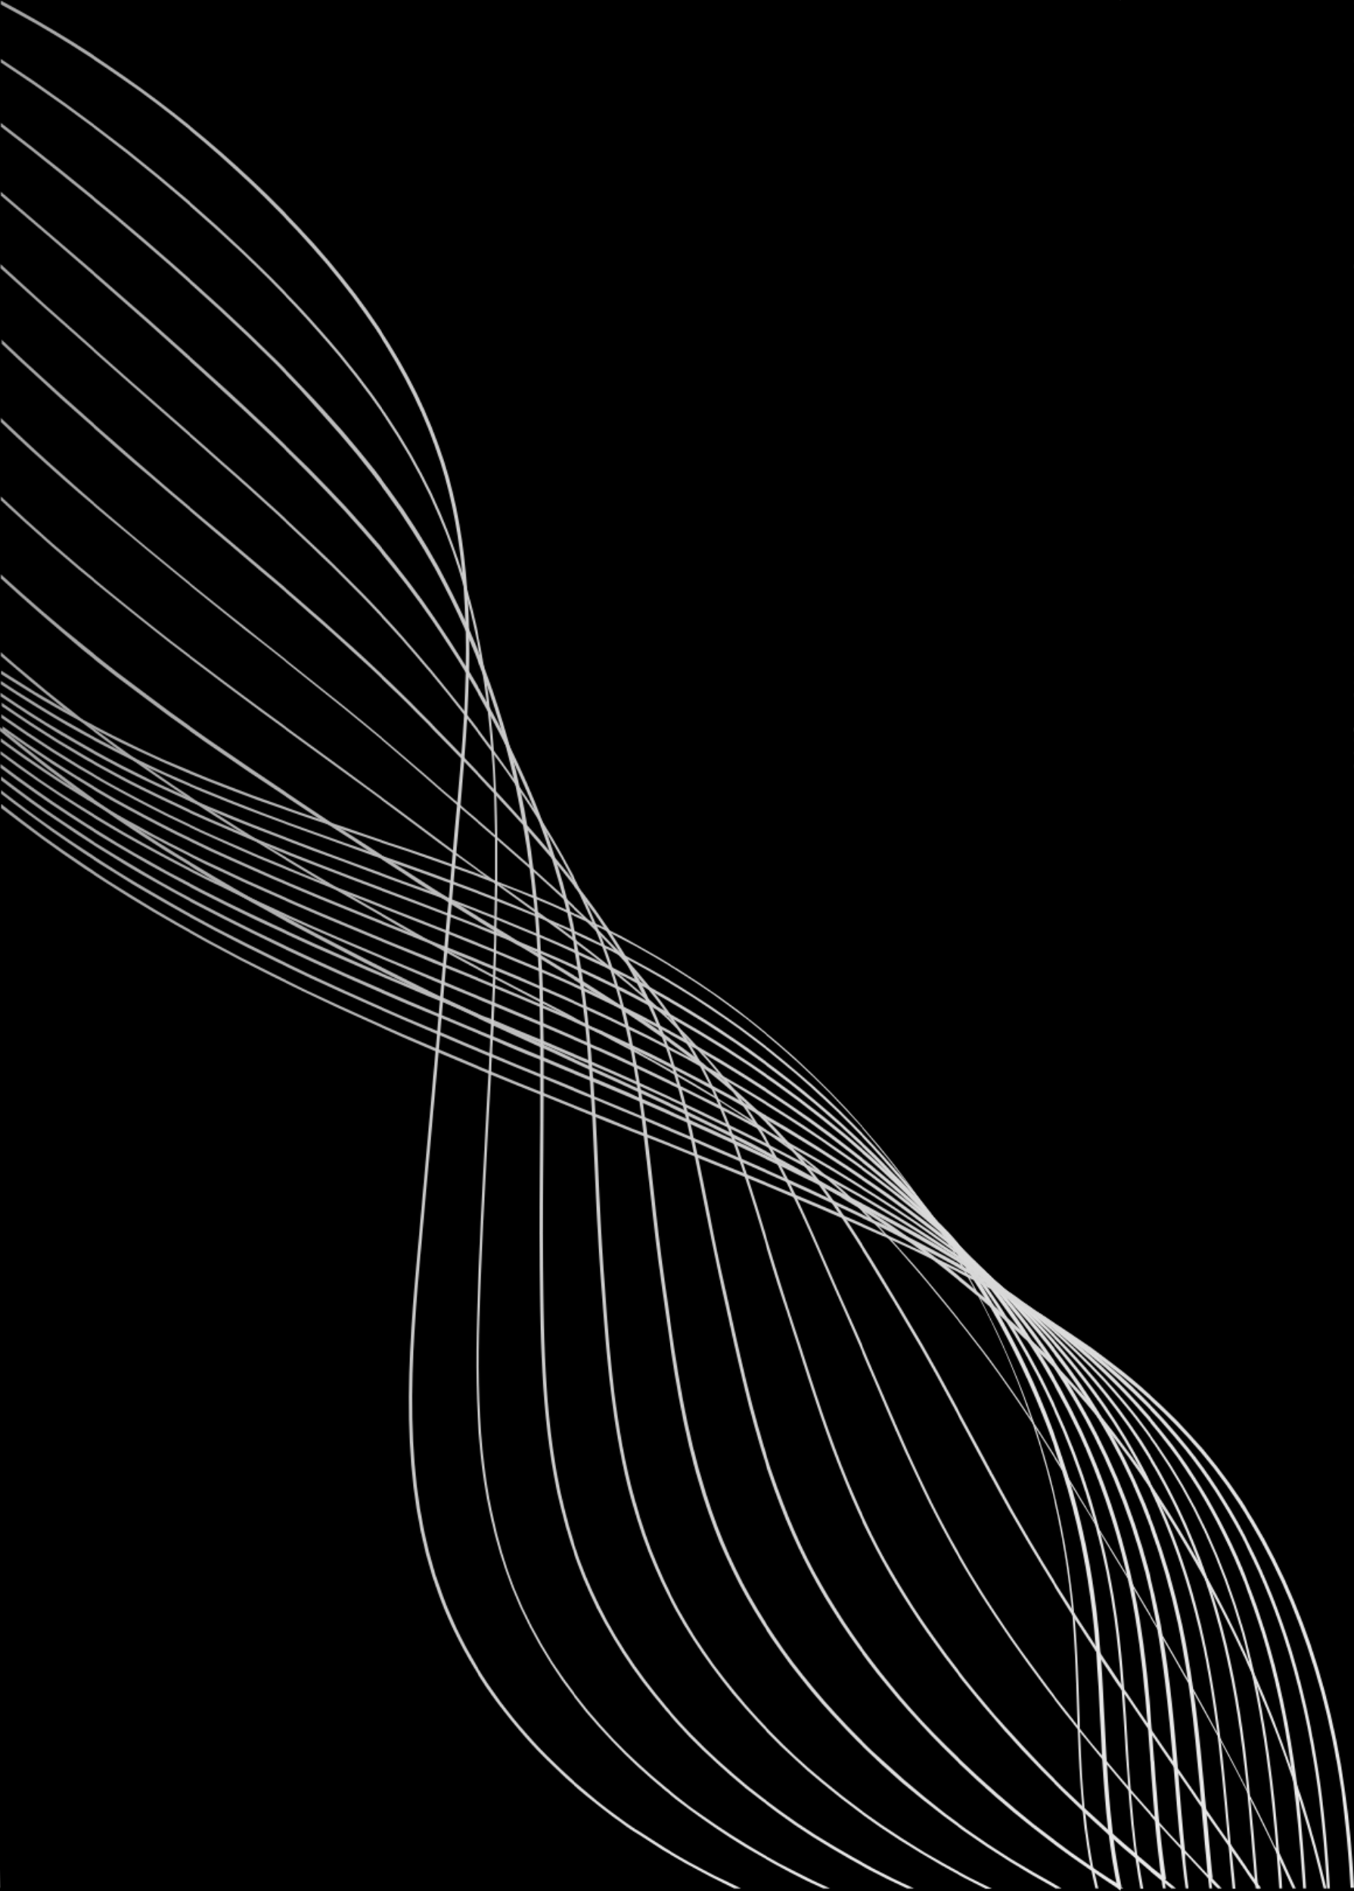
INTRODUCTION
Legal documents are complex, time-consuming to read, and require legal expertise.
Lawyers, businesses, and individuals face challenges in understanding obligations, clauses, and document types.
ClauseWise automates legal document analysis using AI to simplify, classify, and extract critical information.
Visuals: Illustration of a lawyer looking at a stack of documents or AI icon analyzing papers
01

Slide 3
PROBLEM STATEMENT
Manual reading is slow and prone to errors.
Legal jargon is difficult for non-lawyers.
Identifying important clauses and obligations is time-consuming.
Classifying documents into types manually is inefficient.
Visuals: Bullet list with icons or infographic of challenges
02

Slide 4
ARCHITECTURE
Backend: Python, IBM Watson NLP, Granite AI
Document Processing:
OCR (pytesseract) for images
PDF/DOCX parsing (PyPDF2, python-docx)
AI Analysis:
Clause simplification
Named Entity Recognition (NER)
Clause extraction & breakdown
Document type classification
Frontend: Streamlit / Gradio for interactive UI
Visuals: Flowchart showing user upload → text extraction → AI analysis → results
03

Slide 5
SOLUTION
Clause Simplification: Converts legal jargon into plain language
Named Entity Recognition (NER): Extracts parties, dates, obligations, monetary values
Clause Extraction & Breakdown: Segments individual clauses for focused analysis
Document Type Classification: NDA, lease, employment, service agreements
Multi-Format Support: PDF, DOCX, TXT
User-Friendly Interface: Interactive, intuitive frontend for users
Visuals: Icons representing each feature or screenshot of interface
04

Slide 6

FUTURE SCOPE
Support additional document formats like HTML, scanned images, or handwritten contracts
Multi-language document processing
Mobile-friendly application
Integration with cloud storage and enterprise legal management systems
AI-based predictive insights (risk assessment, compliance alerts)
Visuals: Growth/roadmap illustration or icons representing scalability and AI expansion
05

Slide 7
CONCLUSION
ClauseWise simplifies legal document workflows with AI-powered automation.
Combines IBM Watson NLP and Granite AI for powerful clause analysis and document classification.
Saves time, reduces errors, and improves comprehension for both professionals and laypersons.
Provides structured, downloadable analysis reports through an interactive interface.
Visuals: AI + legal documents illustration or summary infographic
08

